Slide 1
ConnecTV User Support and Troubleshooting

Slide 2
Introduction
What is ConnecTV?
ConnecTV is a full-featured video service delivered to your TV, laptop and mobile devices, exclusively from LUS Fiber.
A modern feature set allows users to have what they want, when they want it on all of their favorite devices.
Features:
Cloud DVR
Restart TV
Replay TV
Video On Demand
Apps for all of your mobile devices
Web interface for your home PC
24/7 Hometown Technical Support

Slide 3
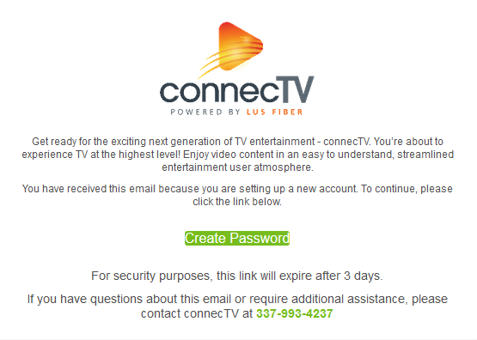
Onboarding New Users
How are user accounts and passwords created?
Once a student has been checked into housing at UL, their account will be automatically created within 24 hours. An email will be sent to the student’s ULID email account (C12345678@louisiana.edu) prompting them to create a password for ConnecTV.
If the link expires the user will have the option to enter their email address and request a new link.

Slide 4
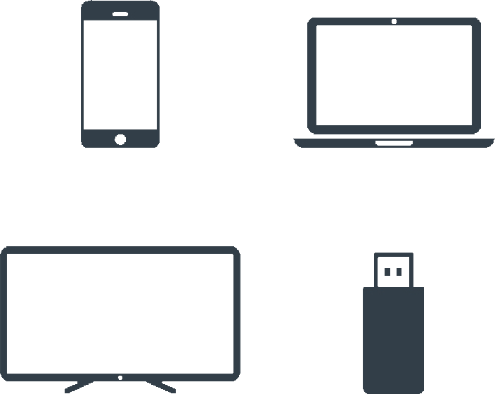
What devices are supported?
Amazon Fire TV/Fire TV Stick, Gen 2+
Android Devices, Android 5.1+
Android TV Devices
Apple TV, 4th Generation+
Apple Devices, iOS 9+
Mac and PC using common web browsers:
Chrome (Win 49+, OSX 55+)
IE (11+ on Windows 8.1+)
Edge 13+
Safari (8+ on Mac OSX 10.11+)
Firefox 47+
See Additional Troubleshooting Resources for a Detailed List of Supported Devices

Slide 5
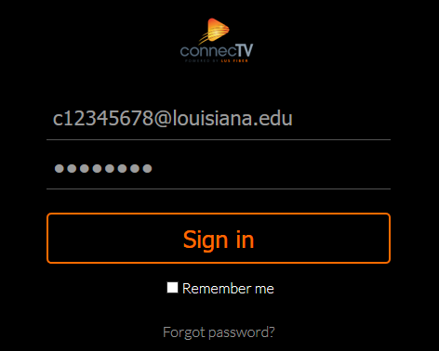
ConnecTV Web Interface for PC and Mac
PC and Mac users will need to use a web browser to watch ConnecTV.
Navigate to connectv.lusfiber.com
Login Credentials: the students’s ULID email address C12345678@louisiana.edu and password that they created during setup.
If the user is having issues with playback ensure that they are using a supported browser. Have the user test with another browser to ensure that an extension or setting is not preventing playback.

Slide 6
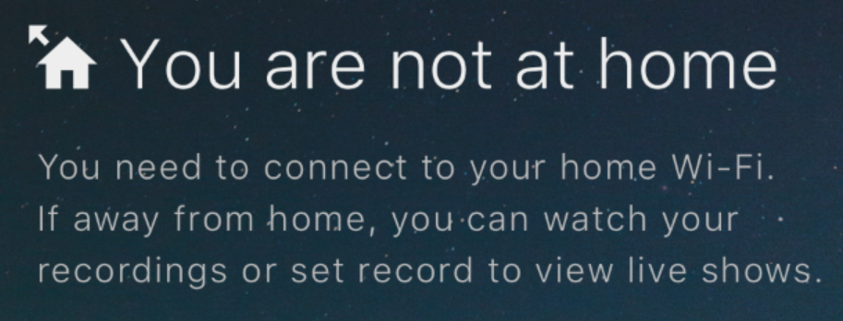
Troubleshooting: You Are Not at Home
ConnecTV can only be watched while using a UL WiFi or a UL internet connection. This message appears when a user attempts to login or watch ConnecTV from another location or while connected only to a cellular data connection.

Slide 7
Troubleshooting: You Are Not at Home
Resolution
Ensure that the user’s device is connected to the UL WiFi or a UL internet connection.
Have the user turn off cellular data to ensure that traffic only travels over the UL WiFi connection.
Have the user reboot the device and relaunch the application.
Use a website like ipchicken.com to verify that the user’s traffic is coming from the correct public ip address range.
Escalate to LUS Fiber if the issue persists.

Slide 8
Troubleshooting: Network Reconnecting Message or Video Buffering
Resolution
Have the user reboot the device and relaunch the application.
The issue may be WiFi signal strength related. If the device is portable, instruct the user to move to the vicinity of a different access point and disconnect/reconnect to force the device to associate to another then test.
The issue may also be device specific, have the user test with another device. If video is good on the new device the user can try to reinstall the ConnecTV app. If this does not resolve the issue, ensure that the device, OS, or browser is on list of ConnecTV supported devices. If the device is supported, but still having performance issues, there may be an issue with the device and the user will have to contact the device’s vendor for support.

Slide 9
Troubleshooting: Stuck on White ConnecTV Splash Screen
Resolution
This may happen when the application launches but does not have network connectivity. Ensure that the user’s device is connected to the UL WiFi or a UL internet connection and try again.
Have the user reboot the device and relaunch the application.
If the issue is not resolved, there may be an issue with the application. Have the user reinstall the application.
Ensure that the device, OS, or browser is on the list of ConnecTV supported devices.

Slide 10
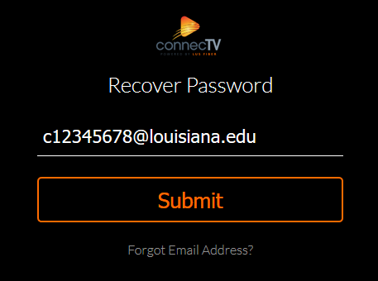
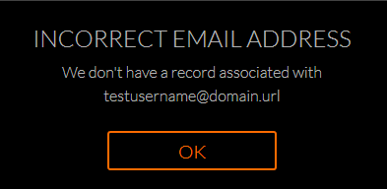
Troubleshooting: Resetting a Lost ConnecTV Password
Navigate to connectv.lusfiber.com
Click on Forgot Password.
Enter the students’s ULID email address C12345678@louisiana.edu and choose submit.
A password reset email will be sent to the user.
If the user receives an Incorrect Email Address message, verify that the user has been checked in to housing for 24 hours and escalate the issue to LUS Fiber.

Slide 11
Common ConnecTV Questions
Video stops playing after two hours is this normal?
Yes, this is normal and designed to help lower data usage. If prompted, click OK to continue enjoying content.
Can I install the ConnecTV app on devices not in the list of supported devices?
Yes, but we cannot guarantee an optimal viewing experience.
I am having trouble with only one device what should I do?
If the user is having issues with only one home device and the others are working: Have them try testing closer to the WiFi access point and reinstalling the ConnecTV application. If the issue is not resolved, there may be an issue with the device. Have the user contact the device’s vendor for technical support.

Slide 12
Thank You for Your part in making UL and ConnecTV a continuing success.

Slide 13
Additional Troubleshooting Resources

Slide 14
Detailed List of Supported Devices
Mobile Phone
iPhone iOS 9+
Android Phone, Android 5.1+
Tablet
iPad iOS 9+
Android Tablet, Android 5.1+
Streaming Stick
Amazon Fire Stick Gen 2+
Streaming STB
Apple TV Gen 4+
Android TV - Nvidia Shield, Xiaomi MiBox
Amazon Fire TV Gen 2+
Smart TV
Android Smart TV - Philips, Sharp, Sony
Fire TV Edition - Element, Westinghouse
Browser
Chrome (Win 49+, OSX 55+)
IE (11+ on Windows 8.1+)
Edge 13+
Safari (8+ on Mac OSX 10.11+)
Firefox 47+

Slide 15
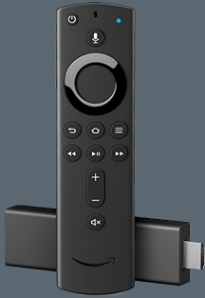
App Installation: Amazon Devices
On Amazon Devices:
Ensure that the device is connected to UL WiFi.
From the home screen click the magnifying glass icon to search and enter “connectv” or “lus fiber”
Choose install and once that is complete open the app.
Login to the ConnecTV app using the email address and password created by the user.

Slide 16
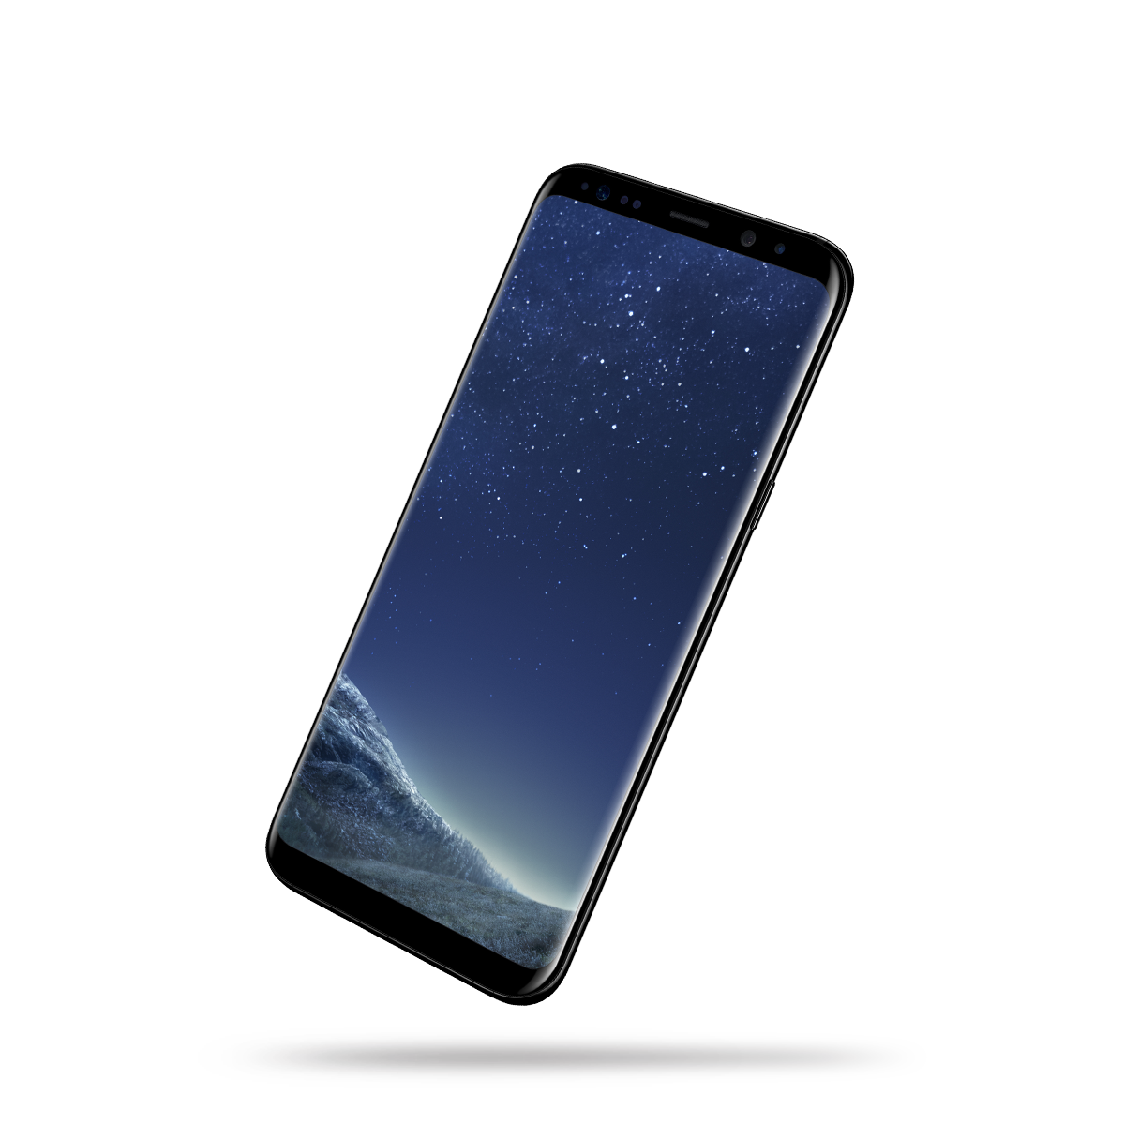
App Installation: Android Devices
On Android Devices
Ensure that the device is connected to UL WiFi.
Open the Google Play Store app and search for “connectv” or “lus fiber”
Select the orange ConnecTV app and choose install.
Enter your google play account credentials if prompted and open the app once installation is complete.
Login to the ConnecTV app using the email address and password created by the user.

Slide 17
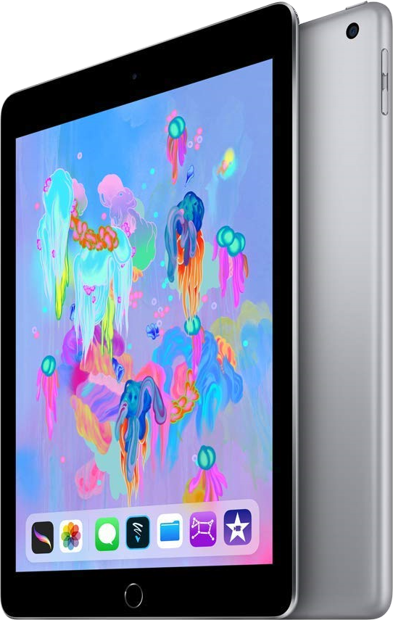
App Installation: iOS Devices
On Apple Devices
Ensure that the device is connected to UL WiFi.
Open the App Store search for “connectv” or “lus fiber”
Select the orange ConnecTV app and choose Get.
Enter your Apple ID and password if prompted and open the app once it has been installed.
Login to the ConnecTV app using the email address and password created by the user.

Slide 18
Resetting Common ConnecTV Devices
Amazon Fire TV and Fire TV Stick
If the user’s device needs to be reset but they do not have access to unplug the device, use the following instructions to assist.
To reset an Amazon Fire TV or Fire TV Stick, have the user hold down the Select and Play buttons on the remote until a message on the screen indicates that the device is rebooting.
This may also be done by choosing the Home button, then Settings, System, and Restart.

Slide 19
Resetting Common ConnecTV Devices
Apple TV
If the user’s device needs to be reset but they do not have access to unplug the device, use the following instructions to assist.
To reset an Apple TV device, have the user hold down the Menu and Home buttons on the remote for 10 seconds and then release them. The screen should go black and the device will restart.
This may also be done by choosing the Menu button to return to the home screen, then the Settings gear icon, System, and Restart.

Slide 20
Resetting Common ConnecTV Devices
Android TV Devices
If the user’s device needs to be reset but they do not have access to unplug the device, use the following instructions to assist.
To reset an Android TV device, have the user hold down the Power button on the remote until a dialog box appears asking if the user would like to shut down the device. Have the user use the arrow keys to highlight OK and then click the center button of the navigation wheel to select it. Once the device has been shut down, click the power button again to reboot it.
If the power button is only pressed and not held down, the device will not reboot and only temporarily go to sleep.

Slide 21
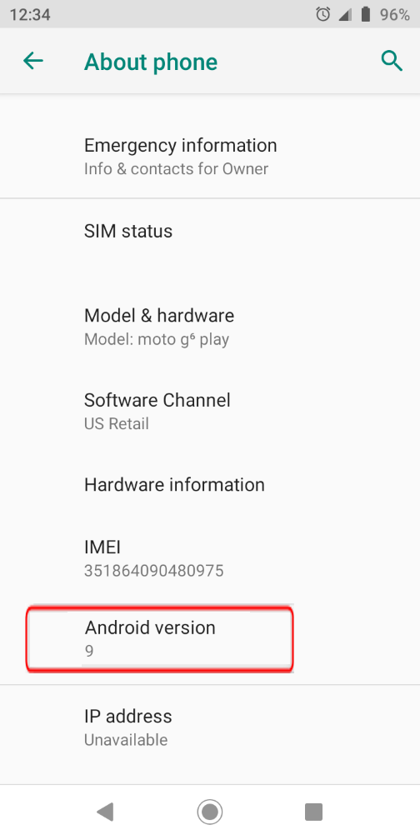
Checking Android Version
Android Phones and Tablets
Check an Android device’s Android version by swiping up from the bottom of the home screen to show all applications, tapping the settings gear, then choosing System, and About Phone.

Slide 22
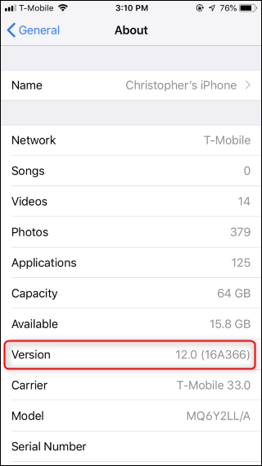
Checking iOS Version
iPhones and iPads
Check an iPhone or iPad’s iOS version by tapping the settings gear, then selecting General, and then Version.

Slide 23
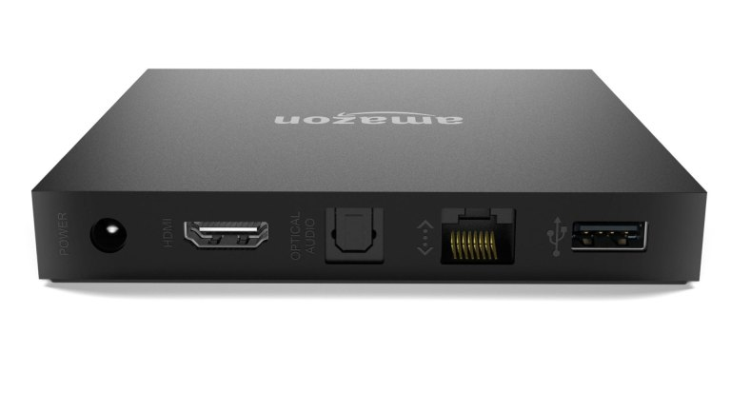
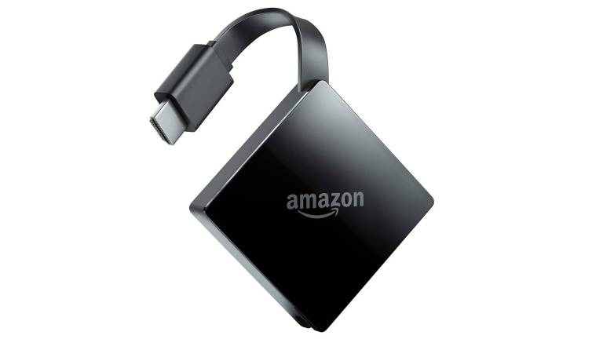
Is My Amazon Streaming Device Supported?
Amazon Fire TV
Amazon Fire TV 1st Generation (Left) is not supported. Fire TV 2nd Generation (Right) and subsequent devices are supported by ConnecTV.

Slide 24
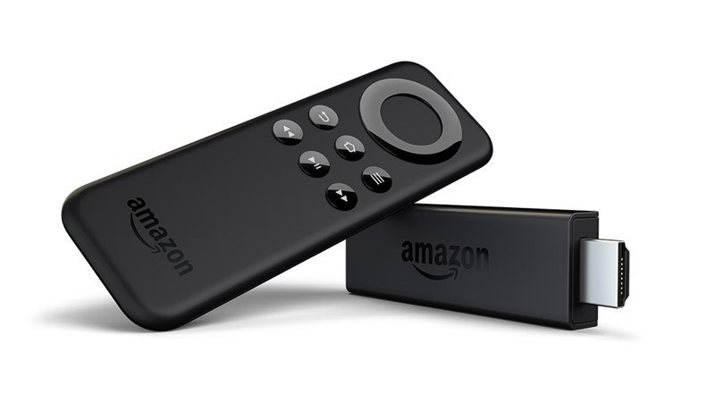
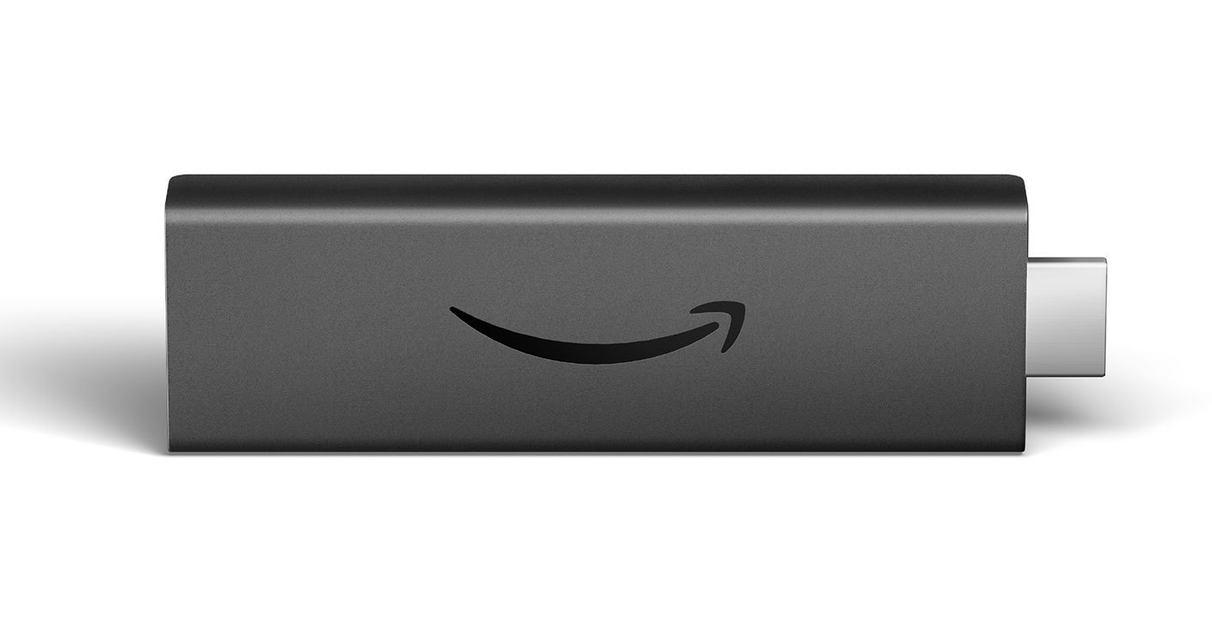
Is My Amazon Streaming Device Supported?
Amazon Fire Stick
If the device has the remote shown below at left or the curved arrow logo with no name below at right, the device is a 1st generation Amazon Fire Stick. For performance reasons, neither of these devices are supported. All subsequent models are supported.

Slide 25
Is My Apple Streaming Device Supported?
Apple TV
If the device is a 1st Generation (Left), 2nd, or 3rd Generation (Center) Apple TV the device is not supported. If the device is 4th Generation (Right) or later, the device is a supported ConnecTV streaming device.

